Slide 1
HANDLING APPLICATIONS BY SPEECH RECOGNITION
Project Mentor: Project Members:
PROF. RADHA R. SHUBHAM THAKUR(15030141CSE083)
VAIBHAV PATHAK(15030141CSE107)
VIPUL KUMAR JHA(15030141CSE114)
SUSHANT JHA(15030141CSE097)

Slide 2
Contents:
Abstract
Introduction
Design Model
Implementation
Requirements
Conclusion and Future Enhancement
Reference.

Slide 3
Abstract:
Gesture have been an integral part of human interaction since old times. Most gestures originate from either face, hand or voice based.
Our project’s target is to allow PLUTO to do “speech recognition” and “text recognition” meaning that it would be able to recognize both Text or Speech commands and perform operations of opening applications.

Slide 4
Introduction:
In 2005, Android is Officially own by GOOGLE and in today’s world 80% of mobile phones are running on android OS, that is why we chose android platform for our project.
Our application recognizes the words user speaks and converts it to text then matches with keywords in the code for tasks, if it matches then it performs the task spoken to it. If the user speaks “open camera” then it converts the word spoken into text and then matches the text with the predefined keywords and opens the application.
Our goal for this project is to reduce the user’s time for searching an application from number of applications.
Our app PLUTO can recognizes both Text or Speech commands and perform operation of opening applications.
It uses Java platform and it’s APIs.

Slide 5
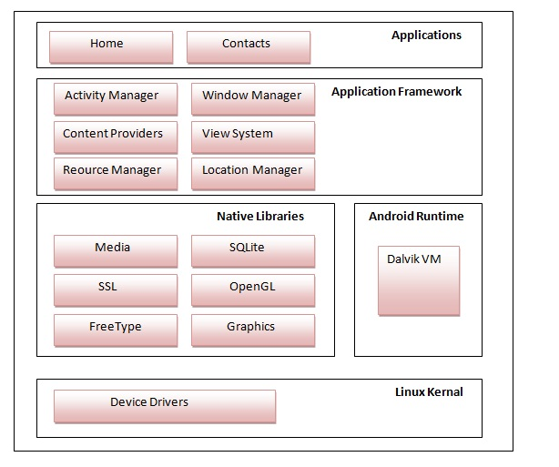
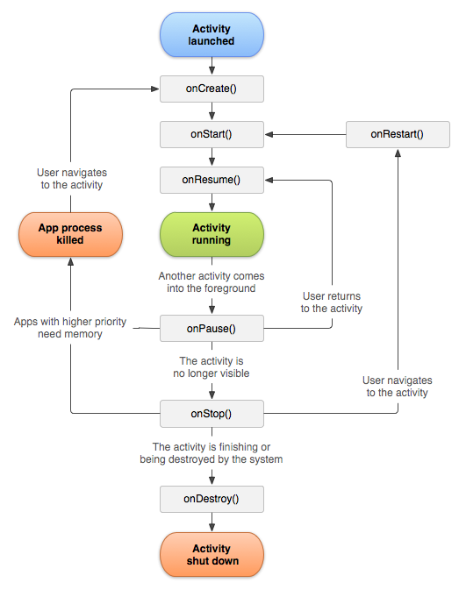
Design Model: Architecture Android Life Cycle

Slide 6
Implementation:
In our project, we are using XML and JAVA for Front End and Back End respectively.
We are working on Mobile Domain and using Android Studio as Development Environment.
We have used JAVA platform and it’s API’s.
We divided our project into 2 parts: Speech Recognition and Text Recognition.
In Text Recognition we have used Intent Class, it’s object and its methods that recognition our pre-defined words and do the operations.
In Speech Recognition part we have used GOOGLE Speech API’s to understand our word and display in the Text Box. If that word is in the list of our pre-defined words, then it will do it’s respective operation otherwise it will display an appropriate message.

Slide 7
Continued…
DOMAIN: | MOBILE
PLATFORM: | JAVA
BACK END | JAVA
FRONT END | XML
DEVELOPMENT ENVIRONMENT | ANDROID STUDIO

Slide 8
Requirements: UI Tested On:
Computer running Windows, Linux or MAC OS X
Java SDK
Google Android SDK
Integrated Development Environment(IDE).
2 GB RAM min.
800 MHz Processor min.
Android Emulator

Slide 9
Conclusion and Future Enhancement
Our app. is very useful in daily life but also limited to do operation of opening other applications only.
It’s having a very simple UI, because the usage of low level APIs. We used low level API’s so that it could support most of android versions, but in future we will:
Use high level API’s for more functionalities.
Improve the UI.
Extends it’s capability i.e. in future, it can control more activities of phone.
Improving Speech Recognition capability
Make use of Internet to search any queries and quickly get relevant solutions.

Slide 10
References:
https://developer.android.com/index.html
https://stackoverflow.com/
https://www.javatpoint.com/

